Slide 1
Update on Hardware Testing
Steve Conard
29 July 2016
IOTA Conference, Stillwater, OK
Revised 17 Nov 2016 with corrections to pages 31, 32, 33, and 34

Slide 2
ONAG System Use

Slide 3
High Speed Data Collection
Only a few high speed data collections were attempted since the October meeting
These were all lunar occultation disappearances
The most successful was the Aldebaron total lunar occultation event in January

Slide 4
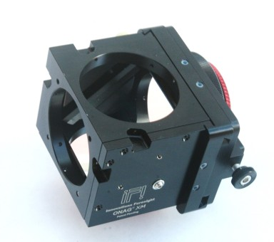
“Standard” Test Set-up for Bright Targets
C-14 on GEM mount
Innovations Foresight ONAG-XM (On-Axis Guider)
Visible leg
Meade 0.33x reducer
Stellacam EX analog video camera
NIR leg
Innovations Foresight Adjustable Focal Reducer
Camera being tested
Image from Innovations Foresight website

Slide 5
ZWO ASI 224 MC
Small (62 mm diameter), lightweight
USB 3 interface
1/3” format, 3.75 µm pixels, 1304 x 976
Color, low noise CMOS
Sony Exmor/NIR sensor
Read noise ~1.5 e
10-bit or 12-bit images
Exposures as short as 32 µsec
2 x 2 binning supported, region of interest windowing
Frame rates as high as 580 fps windowed in 10-bit mode
Important: This camera has a rolling shutter!
Pixels across the frame have their exposures started and stopped at different times
This makes absolute timing more challenging

Slide 6
ZWO 224 in NIR
Even though it is a color sensor, it’s performance only minimally impacted operating in the NIR
At ~825 nm and longer, the color sensor behaves fairly similar to a monochrome sensor
ONAG Transmit Leg

Slide 7
Aldebaron Image from ZWO Camera
Poor image quality is primarily due to defocus
Needed to make sure image wasn’t saturated
Even if fully focused, there is considerable astigmatism on NIR leg due to transmission through a 45 degree dichroic window
Currently have an astigmatism corrector on order to allow for good NIR focus for fainter targets

Slide 8
Aldebaron Disappearance
For this event, a C-14 fed an Innovations Foresight ONAG-XM (On-Axis Guider) provided by Bruce Holenstein
The visible leg had a Stellacam EX camera running without integration, with an IOTA VTI
The NIR leg had a ZWO 224 color camera running at approximately 230 Hz (binned by 2x2, windowed)

Slide 9
Visible Leg 30 Hz

Slide 10
Visible Data

Slide 11
NIR Leg ~230 Hz

Slide 12
NIR Leg

Slide 13
Comments on ONAG Use
Seems to work very well, need to start pushing the envelope and trying fainter targets
Focus is difficult to get right, but once set seems to hold pretty well
We just obtained an astigmatism corrector, which should help with limiting magnitude/frame rates for the transmit leg
Don’t underestimate the difficulty in operating two sensors at the same time on the same telescope
This is part of the reason we’ve not used them as much as anticipated since we obtained them almost a year ago
Which is pretty ironic, considering one of the reasons for getting them was to mitigate our risk of using a high speed camera on a high
May be a bit unwieldy for large or heavy camera systems
But the ONAG XT is very heavily built, so it is not likely to be the limiting factor

Slide 14
Mini DVRs for Data Collection

Slide 15
History
I had started ~8 years ago using a video to USB converter, and recording directly to my laptop
I had problems with dropped frames and hard drive issues, so on David’s recommendation switched over to using pre-owned Canon ZR-65’s exclusively
My first ZR-65 of these lasted >4 years, and was completely reliable
Finally stopped being able to record (recording is either jail-bars or just a blue screen)
Since then, I’ve bought at least 7 more, and most of them failed recently the same way
Currently I have 2 “sort-of” working ones, that aren’t 100% reliable
Given that I liked the quick set-up and portability of these, I started looking for back-ups to the ZR’s

Slide 16
First Attempt—Back to Direct Recording
Added a video amplifier/distributor to my observatory
I purchased a cheap desktop computer for my observatory, for multiple uses
The old video to USB input card only worked with pre-XP windows, so that was shelved, and I bought a Hauppauge card for the PC
Their software allowed pre-set time recording, and I programmed it in advance for events, while continuing to use the ZR’s as the primary recording device
At least twice, the ZR’s failed, and I had back-up data
But after a single winter in the unheated observatory, the desktop computer completely failed, and it was back to having no back-up
Last year, I watched a nice positive live, then found the ZR had failed and I was left only with dicey visual data
Decided to try DVRs, but limited myself to used or units sold by US vendors as I am not comfortable ordering directly from overseas vendors

Slide 17
Second Attempt—Cheap DVRs
No name brand, meant for security recording
$25 new, obtained on Ebay from a US seller
Had to add an SD card
“User Manual” so poor I believe I’d have been better off without one
First didn’t work at all, then obtained a faster SD card
Still didn’t effectively work
Extremely poor quality of data, many dropped frames, difficult to use, unreliable
Gave up as a lost cause and gave away
Similar looking to this one, but not same brand or vendor

Slide 18
General Features of the Following DVRs
All have a display
3 of the 4 displays are borderline too small to be very useful
The other with the larger display actually is really nice!
All only save every other field, at 30 Hz
You get only the odd or the even field
All have built in batteries that seem to last a long time
But I have not done any duration measurements, but it is in hours
All are small and lightweight
All require a SD card (little or no on-board memory)
None (surprisingly to me) have timed recording
Most have a ¼-20 hole for tripod mounting

Slide 19
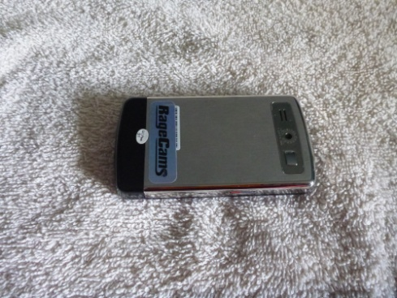
DVR #2 Ragecams JXD
Ragecams JXD, unknown part number, no longer made
Made for security recording and a mini-camera
Found this one on Ebay used for ~$40 without any documentation
Very well built mechanically
Metal back shell
Fairly difficult to use, especially to get into high resolution (aka full resolution to us) mode

Slide 20
DVR #3 Readymade RC
Readymade RC RMRC Pro-1200
Made for displaying and recording video from RC airplanes
Available new for $150
Nice features
By far the largest and highest resolution screen
Fold up hood
Has a radio receiver as well as hardware video input
Easy to use

Slide 21
DVR #4 Ragecams DVR III
Ragecams Mini DVR III
Made for security recording
Currently available new for list price of $300 from Ragecams
I purchased at a significant discount
Easy to use
Recently completely failed within 6 months of purchase
Working on getting it repaired under warranty

Slide 22
DVR #5 Stuntcams HD
Stuntcams HD Mini DVR
Intended for security or wearable camera
Currently listed for $289, but without HD camera attachment
Required separately purchased video in cable for about $20
Supposed to record (848 x 480) analog video at 60 Hz, what I would interpret as every field
Vendor said this was the only DVR in this price range to do this
Several different tests show it is only recording every other field

Slide 23
Features
 | Ragecams | Readymade RC | Ragecams | Stuntcams
Model | JXD | RMRC Pro-1200 | Mini DVR III | HD Mini DVR
Price | N/A | $150 | $250* | $289
Size | 94 x 55 x 11 mm | 130 x 90 x 27 mm | 78 x 54 x 20 mm | 75 x 55 x 20 mm
Screen Size | 3” | 5” | 2.5” | 2.5”
Screen Aspect Ratio | ~16 x 9 | 16 x 9 | 4 x 3 | 4 x 3
Screen Resolution | Unknown (low) | 800 x 480 | 920 x 240 | 960 x 240
“Automobile Mode” | No | No | Yes | Yes†
Video File Type | MP4 | AVI | AVI | MOV
* Approximate price after discount
† Requires special cable at additional cost

Slide 24
Performance
 | Ragecams | Readymade RC | Ragecams | Stuntcams
Model | JXD | RMRC Pro-1200 | Mini DVR III | HD Mini DVR
KB/second | 134 | 227 | 894 | 517
Image Size | 352 x 224* | 720 x 480 | 720 x 480 | 848 x 480
* Later found that there is a higher resolution mode available, but difficult to find in the menu system

Slide 25
Delayed Recording
None of these units allow you to preprogram times to start and stop recording
I would have thought those that are intended for security use would have this feature
But any that have “Automobile mode” can be inexpensively converted to do this
This mode is intended to have the unit record in a car whenever the car is running
Looks for external power to be applied, and automatically records whenever power is applied
Note that I’ve found that not all vendors know that their units have this feature
One I purchase thinking it didn’t have it, actually did

Slide 26
Delayed Recording
A NEEWER Digital Time Switch (Cn101A) from various Ebay vendors does the trick
<$10 shipped
Simple wiring of 12 volt DC on input and output
Set time on unit
Set on and off time for output power
Will then apply 12 volt to DVR at desired time to start recording
Make sure DVR’s Automobile mode has been activated

Slide 27
Camilla 21 July 2016 Parallel Video Feeds from C-14

Slide 28
Approximate SNR
Star | Magnitude | Direct to Laptop | DVR
1 | 11.3 | 5.5 | 4.1
2 | 10.6 | 6.0 | 4.3
3 | 9.9 | 7.2 | 6.6

Slide 29
Example of Low SNR Recording

Slide 30
Comments
Other than video quality (!), these are nicely featured and very compact
For targets with good signal level and magnitude drop, they are perfectly serviceable
I now routinely use these for back-up on every observation I make

Slide 31
SEXTA System for IOTA Mid-Atlantic

Slide 32
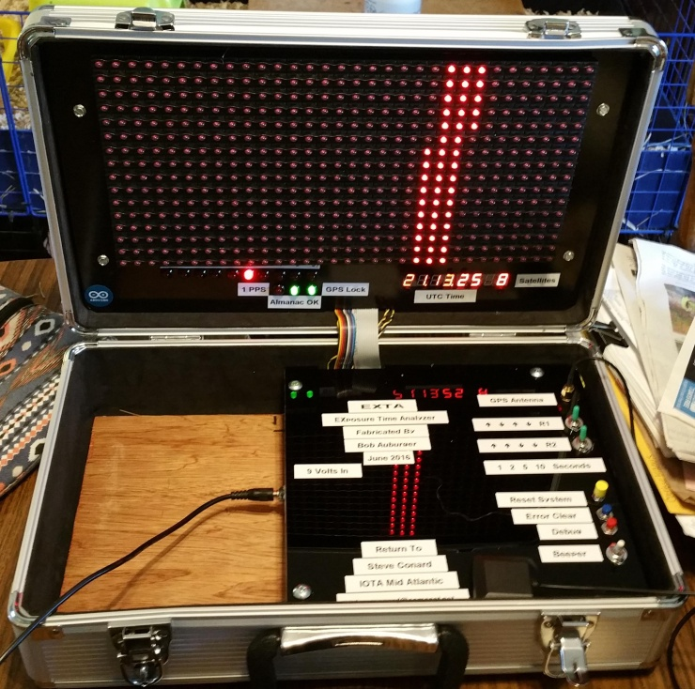
EXTA Box for IOTA Mid-Atlantic
The original EXTA (Exposure Time Analyzer) was invented by Gerhard Dangl
We built a SEXTA (Southern Exposure Time Array), as developed by Tony Barry and Dave Gault
See “Verifying timestamps of occultation observation systems”, Barry et al.
http://www.kuriwaobservatory.com/SEXTA/SEXTA-Paper.pdf
The assembly was done by Bob Auburger, using the excellent online instructions provided by Tony and Dave on the kuriwaobservatory.com website
The system was built into a small tool box, to allow for easy shipping of the system
We intend to loan it out to US IOTA members having a need for it
C-mount lenses are available with it to allow your camera to image the display

Slide 33
What Is It?
SEXTA = Southern EXposure Time Analyzer
This is a GPS receiver, that displays time by illuminating 500 individual LEDs sequentially for periods as short as 0.002 seconds each
The camera being tested is pointed at the display, and recorded
The resulting image with the camera’s (or time inserter’s) time stamp can be compared to the EXTA’s display to calculate absolute time error

Slide 34
Why Do We Need It?
It just looks neat, and is a great conversation piece
Imaging borrowing it for your next dinner party!
Gerhard, Tony, Dave, and others have already performed measurement on the vast majority of analog cameras and time inserters used in our work
There is likely little to be gained here, except to test a few of the odd cameras out there (for example, verifying my Stellacam EX’s and monochrome Malincam behave like Mintron 12V’s)
The primary driver for our fabricating this device is for testing the time accuracy of less typical cameras that may be used for specialized observations (very faint targets, high speed recording, etc.)
emCCDs
Low noise CMOS

Slide 35
Controls and Inputs

Slide 36
Display

Slide 37
Video—Stellacam EX with Integration

Slide 38
Example Image with Kiwi

Slide 39
Example Image with Kiwi

Slide 40
Example Image with Kiwi

Slide 41
Demonstration of Operation

Slide 42
Near-term Use Plans
Testing of emCCDs at Bruce Holenstein’s company is tentatively scheduled for next Saturday
Test timing accuracy of cameras and control software developed by Dylan Holenstein
Still have strange results from a total lunar occultation collected at high speed last year we want to get to the bottom of
Testing of ZWO 224 camera at high frame rates
Testing of Joan Dunham’s ZWO and QHY cameras

Slide 43
Want to Borrow It?
We expect that it will be in fairly regular use for our team’s work for the next few months
After this period, we will likely be willing to loan it out for a few weeks at a time to any US IOTA members who are interested
You will need to pay for shipping both directions to do this
If you are interested in doing this, contact me at steve.conard@comcast.net

